Slide 1

Srilasya Garigipaty Student # 100822953 Final Project-DATA 1200

Slide 2
Description of Problem
Mr. John Hughes has been given a dataset called illnessstudy. The dataset contains 30 attributes of tumor measurement which are the independent variables as shown below:
radius_mean', 'texture_mean', 'perimeter_mean', 'area_mean', 'smoothness_mean', 'compactness_mean', 'concavity_mean', 'concave points_mean', 'symmetry_mean', 'fractal_dimension_mean', 'radius_se', 'texture_se', 'perimeter_se', 'area_se', 'smoothness_se', 'compactness_se', 'concavity_se', 'concave points_se', 'symmetry_se', 'fractal_dimension_se', 'radius_worst', 'texture_worst', 'perimeter_worst', 'area_worst', 'smoothness_worst', 'compactness_worst', 'concavity_worst', 'concave points_worst', 'symmetry_worst', 'fractal_dimension_worst'
Mr. John Hughes would like to determine the diagnosis of the cancer tumor, and classify it according to whether the tumor diagnosis is “M” for Malignant or “B” for Benign. This “Diagnosis” variable is the dependent variable as shown below:
Mr. John Hughes has requested for the Following three algorithms to be created to learn more about the information in the illness study dataset and find key insights, as well as determine the model that would be most beneficial in determining the cancer tumor diagnosis:
Support Vector Machines
Naïve Bayes
Decision Tree
'diagnosis']

Slide 3
Methodology Used To Tackle The Problem
The following Algorithms were used to identify the best model to use on illness study dataset:
Support Vector Machines(SVM): Segregates a dataset in the best possible way. SVM constructs a hyperplane in a multidimensional space and separates data into different classes. SVM generates the optimal hyperplane in an iterative manner, which is used to minimize an error.
Naive-Bayes: It is a classification technique based on Bayes’ Theorem, with an assumption of independence among predictors. Bayes Theorem is a theorem that works on conditional probability. Conditional Probability is the probability that something will happen, given that something else has already occurred. The conditional probability can give us the probability of an event using its prior knowledge.
Decision Tree(Classification and Regression Trees):CART for short refers to Decision Tree algorithms that can be used for classification or regression predictive modeling. A node represents a single input variable (X) and a split point on that variable. Leaf nodes (also called terminal nodes) of the tree contain an output variable (y) which is used to make a prediction.

Slide 4
Analysis Methods Description: SVM Algorithm
SVM(“Support Vector Machines”) segregates a dataset in the best possible way. SVM constructs a hyperplane in a multidimensional space and separates data into different classes.
SVM generates the optimal hyperplane in an iterative manner, which is used to minimize an error.
The core idea of SVM is to find a maximum marginal hyperplane (MMH) that best divides the dataset into classes. In order to achieve MMH the margin between classes should have the same distance.
Support vectors are the data points, which are closest to the hyperplane. These points will define the separating line better by calculating margins. These points are more relevant to the construction of the classifier.
A hyperplane is a decision plane which separates between a set of objects having different class memberships.
A margin is a gap between the two lines on the closest class points. This is calculated as the perpendicular distance from the line to support vectors or closest points. If the margin is larger in between the classes, then it is considered a good margin, a smaller margin is a bad margin.

Slide 5

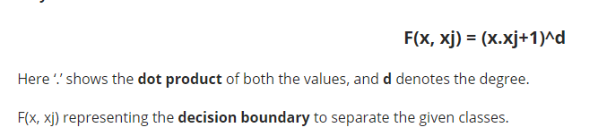
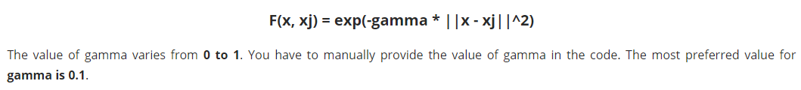
Most Popular SVM Kernels
The SVM algorithm is implemented in practice using a kernel. A kernel transforms an input data space into the required form.
Linear Kernel A linear kernel can be used as normal dot product any two given observations. The product between two vectors is the sum of the multiplication of each pair of input values.
Polynomial Kernel A polynomial kernel is a more generalized form of the linear kernel. The polynomial kernel can distinguish curved or nonlinear input space.
Radial Basis Function Kernel The Radial basis function kernel is a popular kernel function commonly used in support vector machine classification. RBF can map an input space in infinite dimensional space.

Slide 6
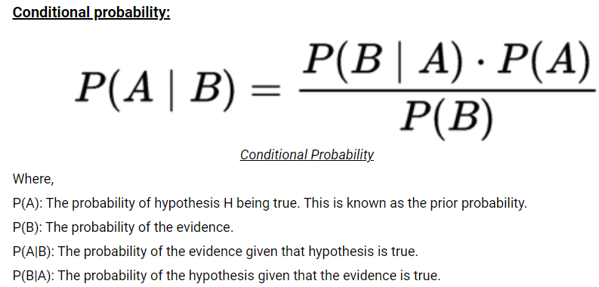
Analysis Methods Description: Naïve Bayes Algorithm
It is a classification technique based on Bayes’ Theorem, with an assumption of independence among predictors.
Bayes Theorem is a theorem that works on conditional probability. Conditional Probability is the probability that something will happen, given that something else has already occurred. The conditional probability can give us the probability of an event using its prior knowledge.
The class having maximum probability is selected as the most suitable class.
The Naïve Bayes algorithm is used in various real-life scenarios such as text Classification, multi-class prediction, recommendation systems, and much more.

Slide 7
Types of Naïve Bayes Algorithms
1. Gaussian Naïve Bayes: When characteristic values are continuous in nature then an assumption is made that the values linked with each class are dispersed according to Gaussian that is Normal Distribution.
2. Multinomial Naïve Bayes: Multinomial Naive Bayes is favored to use on data that is multinomial distributed. It is widely used in text classification in NLP. Each event in text classification constitutes the presence of a word in a document.
3. Bernoulli Naïve Bayes: When data is dispensed according to the multivariate Bernoulli distributions then Bernoulli Naive Bayes is used. That means there exist multiple features but each one is assumed to contain a binary value. So, it requires features to be binary-valued.

Slide 8
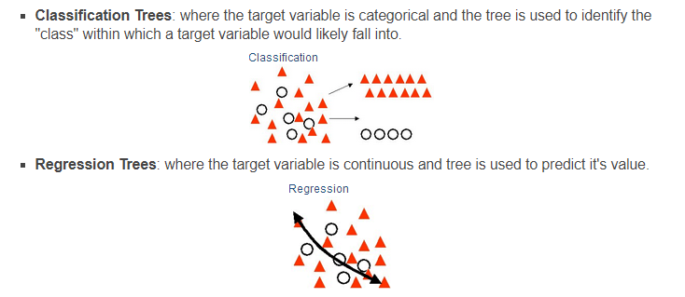
Decision Tree (Classification and Regression Trees):
CART for short refers to Decision Tree algorithms that can be used for classification or regression predictive modeling. A node represents a single input variable (X) and a split point on that variable. Leaf nodes (also called terminal nodes) of the tree contain an output variable (y) which is used to make a prediction.
A decision tree also allows for partitioning data in a much deeper level, not as easily achieved with other decision-making classifiers such as logistic regression or support of vector machines.

Slide 9
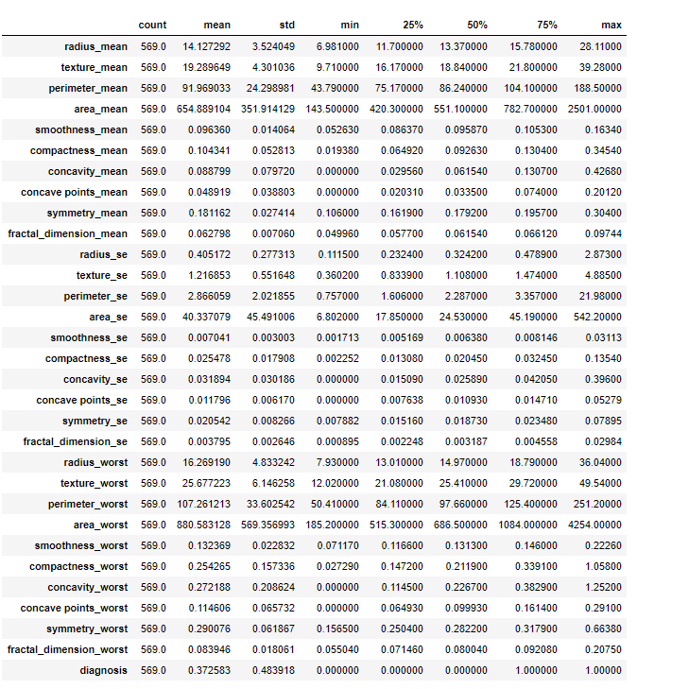
Basic Statistics of The Dataset

Slide 10
Some Insights on Basic Statistics of the Dataset
Correlation ranges from -1 to 1.A negative correlation indicates that as one variable goes up, the other goes down. A correlation of 0 means that two variables are not related at all. A correlation of 1 is perfect correlation, and means that as the ﬁrst variable changes, the second changes in the same direction, though not necessarily by the same amount.
From the correlation function on python code, it was noted that the independent variable “concavepoints_worst” has the most correlation with the dependent variable “diagnosis” at 0.79. The second highest independent variable that is correlated with the dependent variable “diagnosis” is “perimeter_worst” at 0.78. Changes in these two variables will have a large effect on the “diagnosis” that the cancer tumor is either “Malignant” or “Benign”.
The mean is defined as the mathematical average of the data. The mean, maximum values, and minimum values insight will tell how much the variability is affecting the independent variables and what effect this might have on the dependent variable.The mean of “concavepoints_worst” is 0.11 and the mean of “perimeter_ worst” is 107.26.
The maximum value of “perimeter_worst” is 251.2 and the minimum value is 50.4. The maximum value of “concavepoints_worst” is 0.29 and the minimum is 0. This indicates that there is a high variability of “perimeter_worst” points within the dataset. When building a machine learning model , statistics is important to consider. The mean, maximum values, and minimum values insight will tell how much the variability is affecting the diagnosis of the cancer tumor, and what kinds of differences are there between the cancer diagnosis and the wide range of “perimeter_worst” values. The higher the “perimeter_worst” value, the more likely a cancer is to be classified as “Malignant”.
The “concavepoints_worst” variable has less variability compared to ““perimeter_worst” as it is noted that minimum and maximum values are closer together. The variability in “concavepoints_worst” may have little effect on the cancer diagnosis. The higher the “concavepoints_worst” value, the more likely a cancer is to be classified as “Malignant”.
Standard Deviation describes the spread of the observation from the mean. A high standard deviation indicates that the values are spread over a wide range. A low standard deviation indicates that the values are closer to the mean(average) value.
The standard deviation for “perimeter_worst” variable is 33.6 which is far from the mean value of 107.26 indicating a large variation in the variable and further exploring shows this variable has a lot of high and low values in different ranges.
The standard deviation for “concavepoints_worst” variable is 0.06 which is not very far from the mean value of 0.11 indicating a small variation in the variable and further exploring shows this variable has values within close distance of each other.

Slide 11
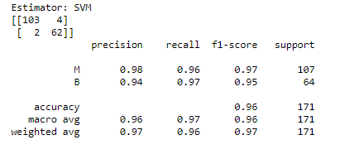
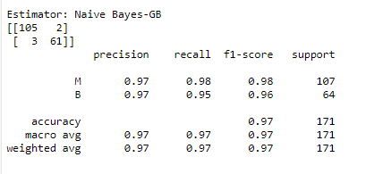
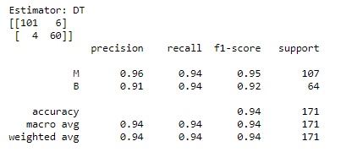
SVM, Naïve Bayes, and Decision Tree Algorithm Results
SVM Confusion Matrix and Classification Report
Naïve Bayes Confusion Matrix and Classification Report
Decision Tree Confusion Matrix and Classification Report

Slide 12
Evaluation Table For All Models
Evaluation Metric | SVM Algorithm | Naïve Bayes Algorithm | Decision Tree Algorithm
Precision | 96% | 97% | 94%
Recall | 97% | 97% | 94%
F1 Score | 96% | 97% | 94%
Accuracy | 96% | 97% | 94%
Confusion Matrix | 2 False Negative, 4 False Positive | 3 False Negative, 2 False Positive | 4 False Negative, 6 False Positive

Slide 13
SVM Model Insights from Findings
There are 2 classes categorized as “B” for a benign cancer and “M” for a “malignant” cancer. The SVM model took a train size of 0.7 and a test size of 0.3 to run the model on.
The final algorithm of the SVM model showed the following results:
Accuracy: Accuracy is the ratio of correct predictions to total predictions made. In SVM model, accuracy was 96%.
Precision: Precision is how accurate your model is . In SVM model, 94% of Class “B” benign cancers were correctly predicted, and 98% of Class “M” malignant cancers were correctly predicted. Overall precision is 96%.
Recall: Recall is the ratio of correctly predicted positive observations to all observations in actual class. In SVM model, Class “B” benign cancer can be correctly predicted 97% of the time. Class “M” Malignant cancers can be correctly predicted 96% of the time. Overall recall is 97%
F1 score: F1 Score is the weighted average of Precision and Recall. In SVM model case, 96% is the F1 score.
The confusion matrix shows that SVM Algorithm misclassified 6 cancer diagnosis out of 569 diagnosis test data the SVM Algorithm was predicted on.

Slide 14
Naïve Bayes Model Insights from Findings
There are 2 classes categorized as “B” for a benign cancer and “M” for a “malignant” cancer. The Naïve Bayes model took a train size of 0.7 and a test size of 0.3 to run the model on.
The final algorithm of the Naïve Bayes model showed the following results:
Accuracy: Accuracy is the ratio of correct predictions to total predictions made. In Naïve Bayes model, accuracy was 97%.
Precision: Precision is how accurate your model is . In Naïve Bayes model, 97% of Class “B” benign cancers were correctly predicted, and 97% of Class “M” malignant cancers were correctly predicted. Overall precision is 97%.
Recall: Recall is the ratio of correctly predicted positive observations to all observations in actual class. In Naïve Bayes model, Class “B” benign cancer can be correctly predicted 95% of the time. Class “M” Malignant cancers can be correctly predicted 98% of the time. Overall recall is 97%
F1 score: F1 Score is the weighted average of Precision and Recall. In Naïve Bayes model case, 97% is the F1 score.
The confusion matrix shows that Naïve Bayes Algorithm misclassified 5 cancer diagnosis out of 569 diagnosis test data the Naïve Bayes Algorithm was predicted on.

Slide 15
Decision Tree Model Insights from Findings
There are 2 classes categorized as “B” for a benign cancer and “M” for a “malignant” cancer. The Decision Tree model took a train size of 0.7 and a test size of 0.3 to run the model on.
The final algorithm of the Decision Tree model showed the following results:
Accuracy: Accuracy is the ratio of correct predictions to total predictions made. In Decision Tree model, accuracy was 94%.
Precision: Precision is how accurate your model is . In Decision Tree model, 91% of Class “B” benign cancers were correctly predicted, and 96% of Class “M” malignant cancers were correctly predicted. Overall precision is 94%.
Recall: Recall is the ratio of correctly predicted positive observations to all observations in actual class. In Decision Tree model, Class “B” benign cancer can be correctly predicted 94% of the time. Class “M” Malignant cancers can be correctly predicted 94% of the time. Overall recall is 94%
F1 score: F1 Score is the weighted average of Precision and Recall. In Decision Tree model case, 94% is the F1 score.
The confusion matrix shows that Decision Tree Algorithm misclassified 10 cancer diagnosis out of 569 diagnosis test data the Decision Tree Algorithm was predicted on.

Slide 16
Recommendation and Justification for Mr. John to use for Analysis
Mr. John should use the Naïve Bayes Model for his Analysis. This is a better model to use compared to the SVM Model and Decision Tree in this situation because it was seen from insights that the precision, recall, accuracy, f1 score were all higher in the Naïve Bayes Model compared to the others and there were fewer number of false predictions.
The Naïve Bayes trains the data quicker than an SVM Algorithm and Decision Tree Algorithm and requires only a small amount of training data to create model for test data .
In classification tasks it is better to have a big data set in order to make reliable estimations of the probability of each class, and Naïve Bayes Algorithm is a powerful model that is not sensitive to big data sets and does not increase in error as number of features increases (dimensionality).
Naïve Bayes is less prone to overfitting compared to SVM and Decision Tree Algorithms. Naïve Bayes can handle multicollinearity in Independent Variables.

Slide 17
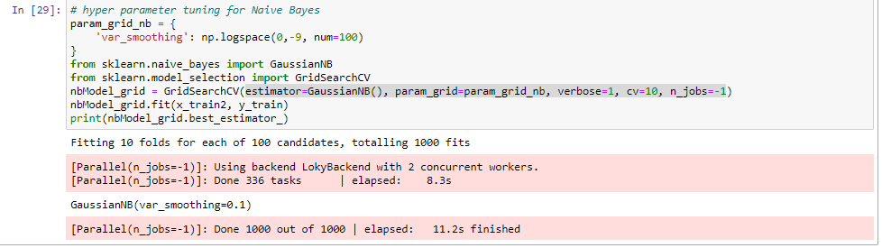
Ways to Improve Naïve Bayes Algorithm
1.Hyperparameter Tuning-A Machine Learning model is defined as a mathematical model with several parameters that need to be learned from the data. However, there are some parameters, known as Hyperparameters that cannot be learned.
Hyperparameters are important because they work by improving performance of the model such as its complexity or its learning rate. Models can have many hyper-parameters and finding the best combination of parameters can be treated as a search problem.
The highlighted section of code indicates the added hyperparameters to Naïve Bayes.
2.Data Wrangling and Manipulation -to fix missing values, and redundant data so that the accuracy and most important features are utilized when model is trained and there is less noise.

Slide 18
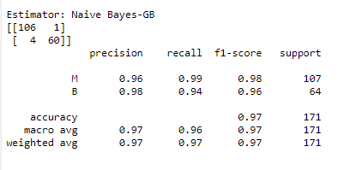
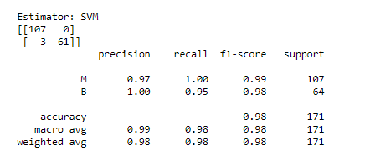
Results of Naïve Bayes After Hyperparameter Tuning
Evaluation Metric | Hyper-Tuned Naïve Bayes Algorithm | Naïve Bayes Algorithm
Precision | 97% | 97%
Recall | 96% | 97%
F1 Score | 97% | 97%
Accuracy | 97% | 97%
Confusion Matrix | 4 False Negative, 1 False Positive | 3 False Negative, 2 False Positive
After Hyper tuning, it was noted that not much improvement was seen as metrics and confusion matrix stayed nearly the same in Naïve Bayes Algorithm. However when hyperparameter method was tried on SVM Algorithm, there was an improvement as shown below.
Evaluation Metric | SVM Algorithm | Hyper-Tuned SVM Algorithm
Precision | 96% | 99%
Recall | 97% | 98%
F1 Score | 96% | 98%
Accuracy | 96% | 98%
Confusion Matrix | 2 False Negative, 4 False Positive | 3 False Negative, 0 False Positive

Slide 19
References
DATA 1200 WEEK 6 AND WEEK 7 NOTES
https://medium.com/analytics-vidhya/how-to-improve-naive-bayes-9fa698e14cba
https://www.analyticsvidhya.com/blog/2017/09/understaing-support-vector-machine-example-code/
https://towardsdatascience.com/all-about-naive-bayes-8e13cef044cf

